Slide 1
AI-Driven Loan Eligibility Prediction
&
Document Verification
Team Members
· Batta Chaitanya Sri (Y22ACM408)
· Dontiboina Naga Lakshmi (Y22ACM427)
· Bellam Ravindra (Y22ACM410)
· Kalagotla Peeraiah (Y22ACM436)
Guide: Ms. Dwija Desireddy (Asst. Professor)

Slide 2
Abstract
Bank loan processing involves verifying applicants’ financial details, which is traditionally done manually, making it time-consuming and error-prone. This paper proposes a hybrid system that integrates document verification with AI-based loan assessment to improve speed, transparency, and efficiency. Applicants submit their financial data along with documents such as identity proof, salary slips, and credit reports. The system automatically extracts and compares this information using LlamaIndex, flagging any mismatches. After verification, a LoRA fine-tuned Qwen model predicts whether the loan should be approved or rejected based on the applicant’s financial profile, while also providing a brief explanation to make the decision clear and understandable.

Slide 3
Existing System — Literature Survey
[1] Bansal et al., 2020
[2] Naik, 2021
ML-Based Loan Prediction
Credit Risk Framework (LightGBM)
Used Logistic Regression, Decision Tree & Random Forest on structured applicant data. Reduced manual effort but relied entirely on structured inputs — no document processing.
LightGBM-based credit default prediction using past borrower data. High prediction efficiency but only structured financial attributes — no document verification coverage.
[3] Liu et al., 2022
[4] Jajoo et al., 2025
Deep Learning Credit Evaluation
LLM Multi-Agent Credit Scoring
Neural network credit scoring outperformed traditional ML models. High computational cost, large training datasets required, no document parsing or verification methods.
Multi-agent LLM system for structured financial data analysis improved credit scoring. However, lacked document validation or automated processing of salary slips, IDs, and credit reports.
3 / 15

Slide 4





Proposed System
AI-Based Loan Eligibility Prediction & Document Verification
Key Modules
01
Smart Loan Application Suite
Digital platform where applicants submit personal and financial details — income, employment, loan amount, dependents, and credit score.
02
Document Processing Automation
Applicants upload identity proof, salary slips & credit reports. LlamaParse extracts key details and converts unstructured docs into structured data.
03
Data Checking & Verification
LlamaIndex cross-matches extracted document values against user-entered data. Any mismatch triggers a flag, ensuring data integrity.
04
AI-Based Loan Evaluation
LoRA fine-tuned Qwen LLM analyzes the financial profile — income capacity, EMI ratio, credit score — and predicts loan approval or rejection.
05
Clear Decision Output
System displays the eligibility status (Approved/Rejected) along with AI-generated natural language reasoning, ensuring full transparency.
4 / 15

Slide 5

System Design — Architecture
End-to-End Processing Pipeline
User
Input
Document
Parsing
Data Pre-
processing
LLM Decision
Engine
Output &
Result
Personal Info
Financial Details
Document Upload
LlamaParse
ID / Salary / CIBIL
Text Extraction
Income Calc
EMI Ratio
Feature Transform
Prompt Build
Qwen Inference
LoRA Tuning
Approved/Rejected
AI Reasoning
Explanation
5 / 15

Slide 6
Methodology
Step-by-Step Implementation Approach
User Input Module
Document Parsing (LlamaParse)
01
Collects name, gender, marital status, dependents, income, co-applicant income, credit score, loan amount, employment & property location via web form.
02
Uploaded documents parsed individually: Identity doc → name; Salary slip → income; CIBIL report → credit score. PDFs/images converted to structured data.
Preprocessing & Feature Engineering
Document Verification (LlamaIndex)
03
EMI Ratio = (Loan/Period) / Usable Income. Usable Income = 50% of Total Income. Dependents categorized: Low/Moderate/High. Repayment capacity computed.
04
Extracted document values cross-matched with user-entered data. Mismatches trigger a flag ensuring data integrity before AI prediction.
Loan Prediction (Qwen + LoRA)
Result Generation
05
Structured prompt with financial profile + verification status passed to LoRA fine-tuned Qwen LLM. Temperature, Top-p sampling & repetition penalty control output.
06
Final output: APPROVED or REJECTED with AI-generated natural language reasoning — helping applicants and institutions understand the key decision factors.
6 / 15

Slide 7
Implementation
Technology Stack & Key Modules
Component | Technology / Tool | Purpose
Frontend Interface | HTML / CSS / JavaScript | Web-based loan application form
Document Parsing | LlamaParse (LlamaIndex) | OCR & structured extraction from PDFs/images
Data Verification | LlamaIndex | Cross-match document vs. user-entered data
AI Prediction Model | Qwen LLM (LoRA fine-tuned) | Loan eligibility prediction with reasoning
Adaptation Method | LoRA (Low-Rank Adaptation) | Efficient fine-tuning without full retraining
Preprocessing | Python (custom logic) | EMI ratio, income calculation, feature transform
File Storage | UUID-based folder structure | Conflict-free document file management
7 / 15

Slide 8
Implementation — Project Files
Key Source Files & Their Roles
app.py
Flask Application Backbone
prediction.py
AI Intelligence Engine
Serves as the backbone of the system built on Flask. Manages user sessions, file uploads and routing across the two-step application process. The Qwen model is loaded once at startup to avoid repeated overhead, and each submission triggers document verification, loan prediction and KPI logging. Error handling is implemented at both route and global level for graceful failure recovery.
Handles the two core intelligence tasks — document parsing and loan decision generation. LlamaParse extracts key fields such as name, CIBIL score and income from uploaded documents, while a rule-based engine evaluates hard rejection criteria. The fine-tuned Qwen LLM then generates natural-language reasoning for the decision, combining rule-based logic with explainable AI for transparency.
index.html
Frontend Application Interface
result.html
Decision Result Template
Defines the frontend interface structured as a two-step form using Bootstrap 5. Step 1 collects personal and financial details — income, CIBIL score, loan amount and employment status. Step 2 handles document uploads including Government ID, salary slip and CIBIL statement. JavaScript fetch calls manage smooth step transitions without full page reloads.
Renders the final loan decision returned by the Flask backend after model inference. Displays applicant details, the LLM-generated reasoning in a styled text box and the final Approved or Rejected verdict with distinct color coding. Navigation buttons allow the user to either reapply or visit the KPI dashboard for insights.
8 / 15

Slide 9
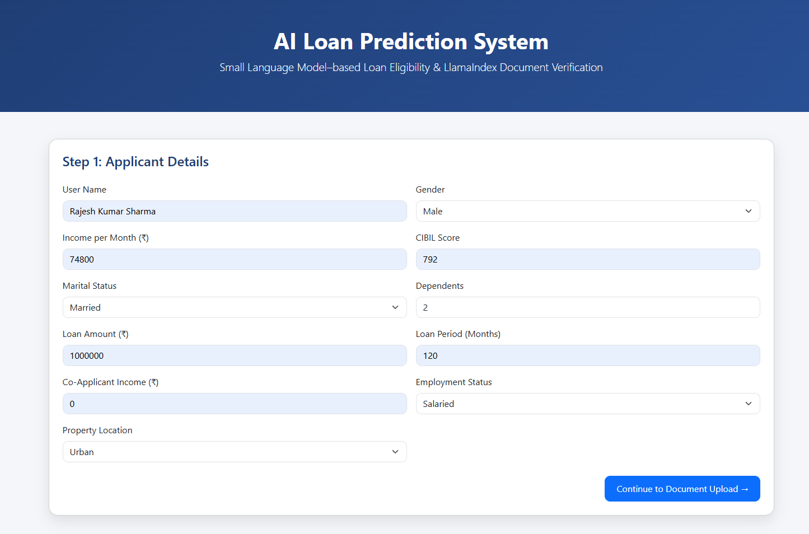
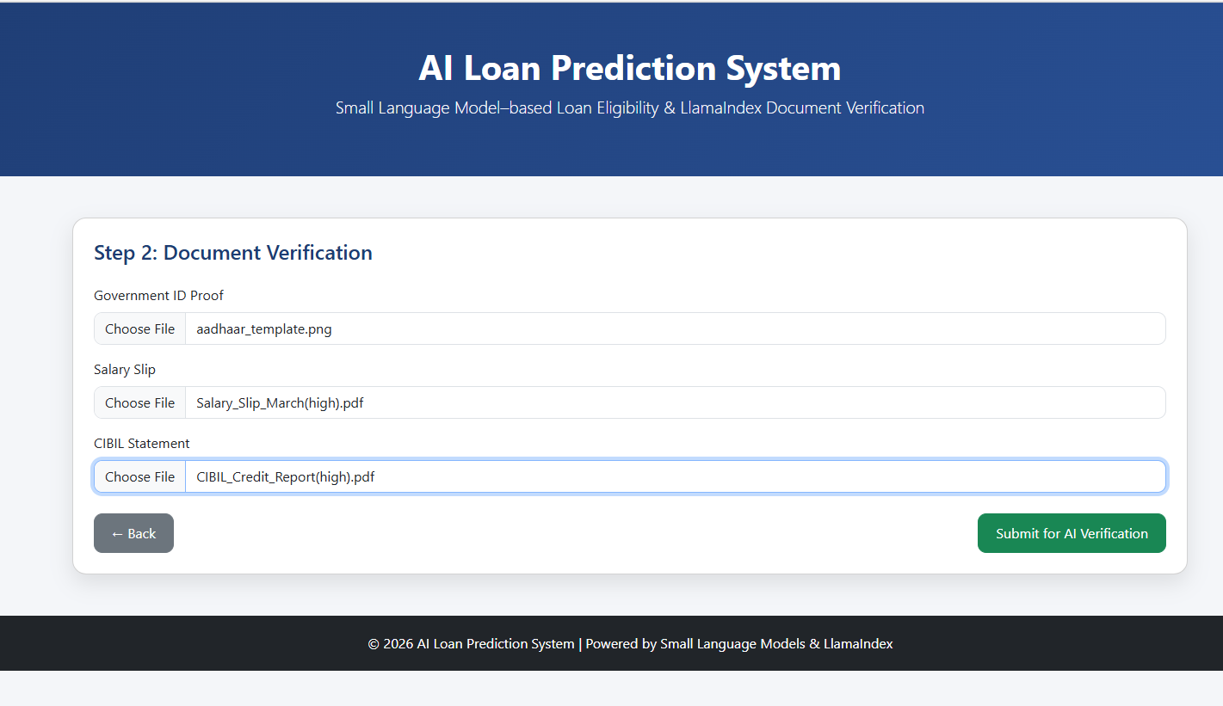
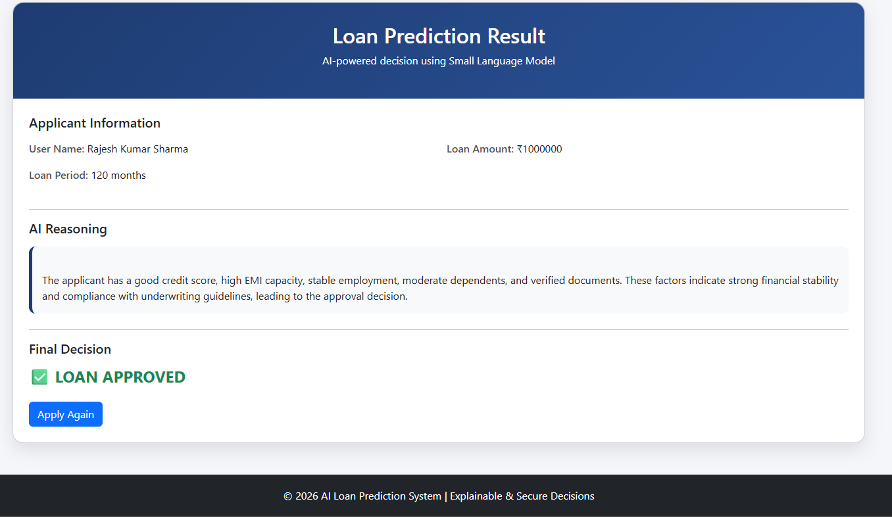
Results — Case 1: Loan Approved
Applicant: Rajesh Kumar Sharma | Income: 74800 | CIBIL: 792 | Dependents: 2 | Loan: ₹10,00,000 | Decision: APPROVED
STEP 1 | Applicant Details
STEP 2 | Document Upload
STEP 3 | Loan Prediction Result
9 / 15

Slide 10
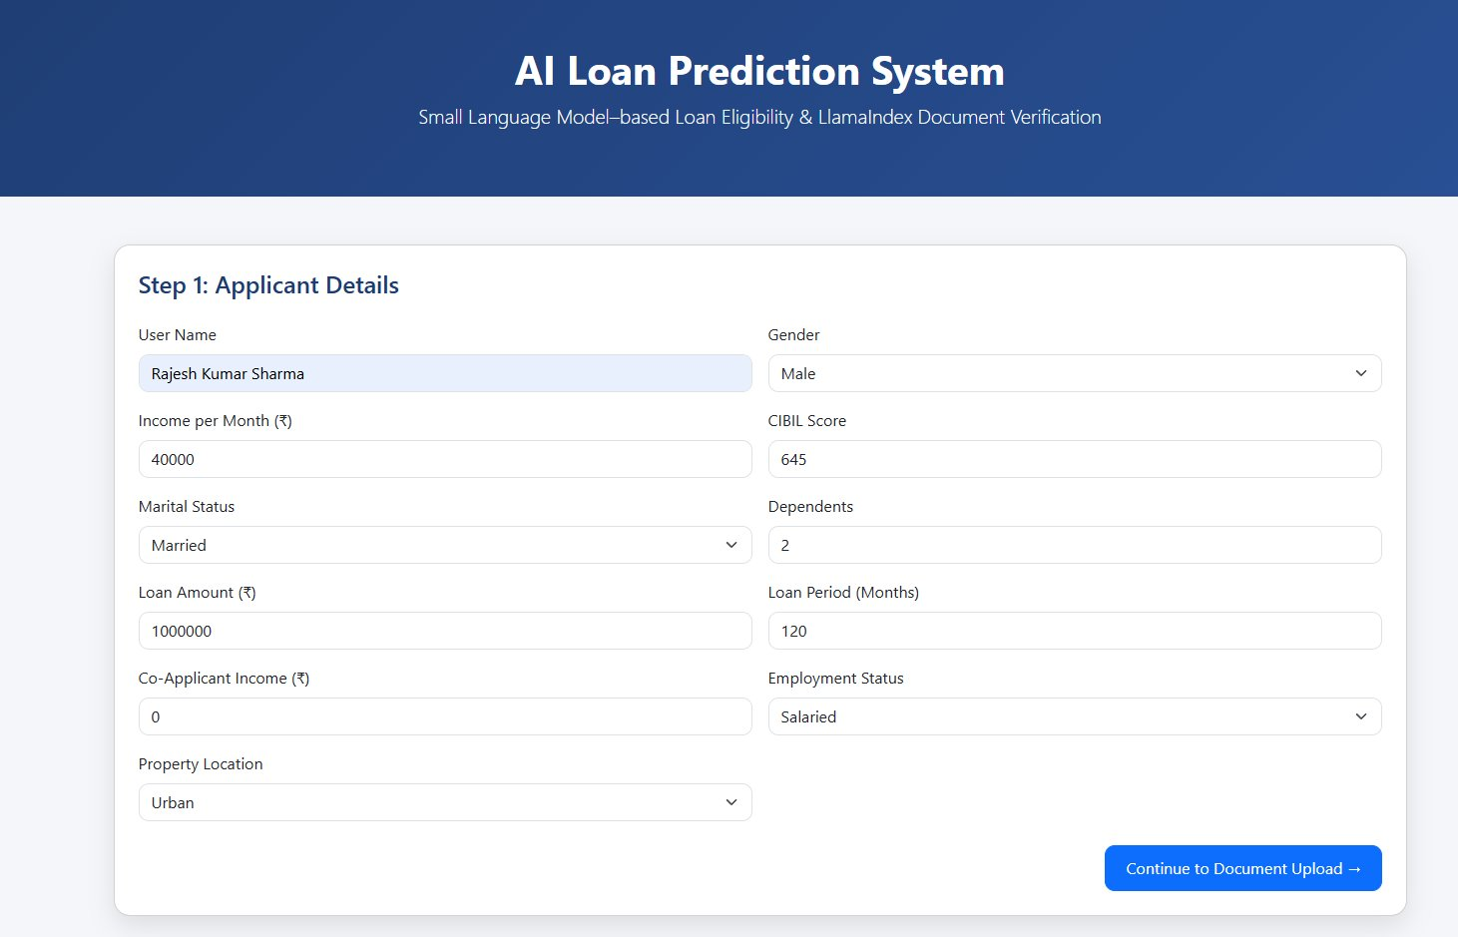
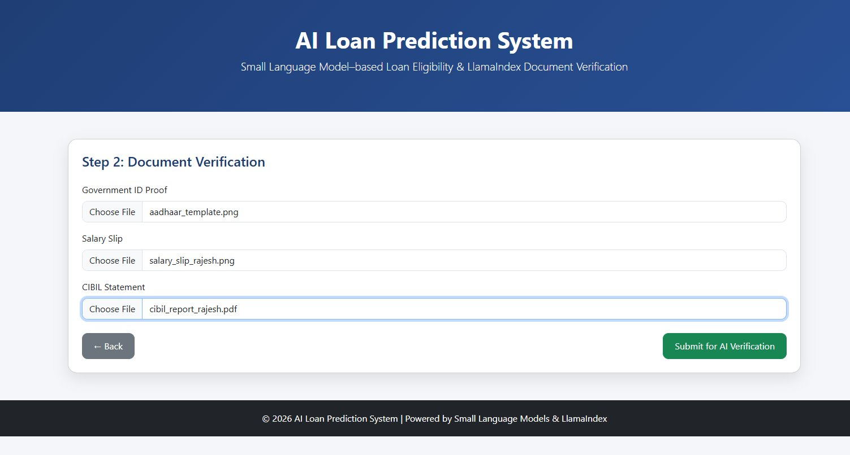
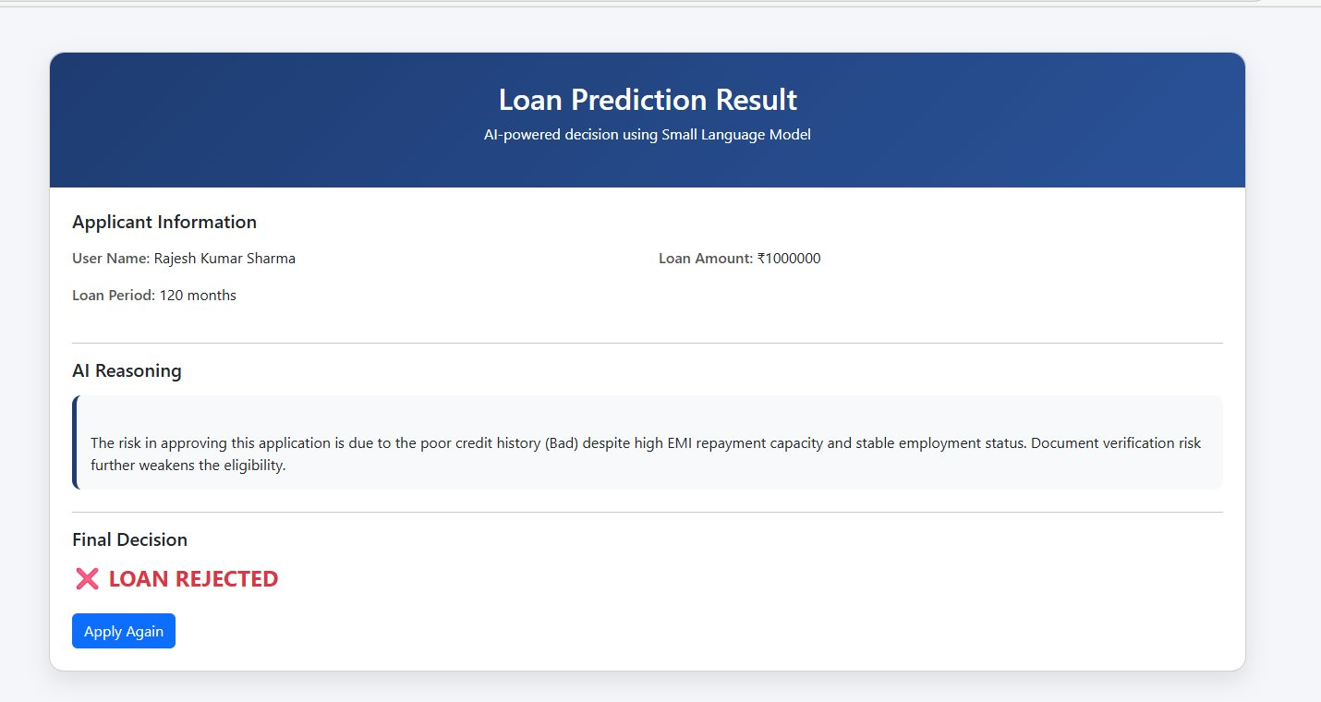
Results — Case 2: Loan Rejected
Applicant: Rajesh Kumar Sharma | Income: 40000 | CIBIL: 645 | Dependents: 2 | Document Verification: Risk | Loan: ₹10,00,000 | Decision: REJECTED
STEP 1 | Applicant Details
STEP 2 | Document Upload
STEP 3 | Loan Prediction Result
10 / 15

Slide 11
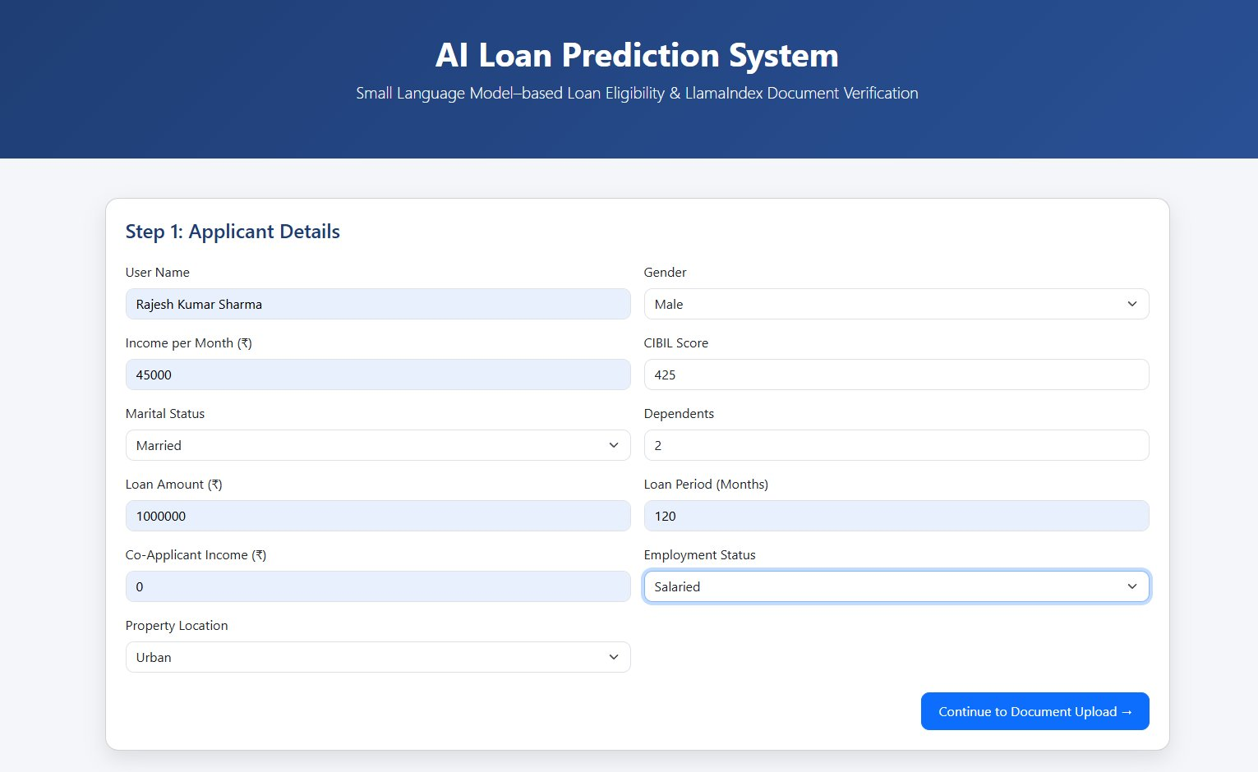
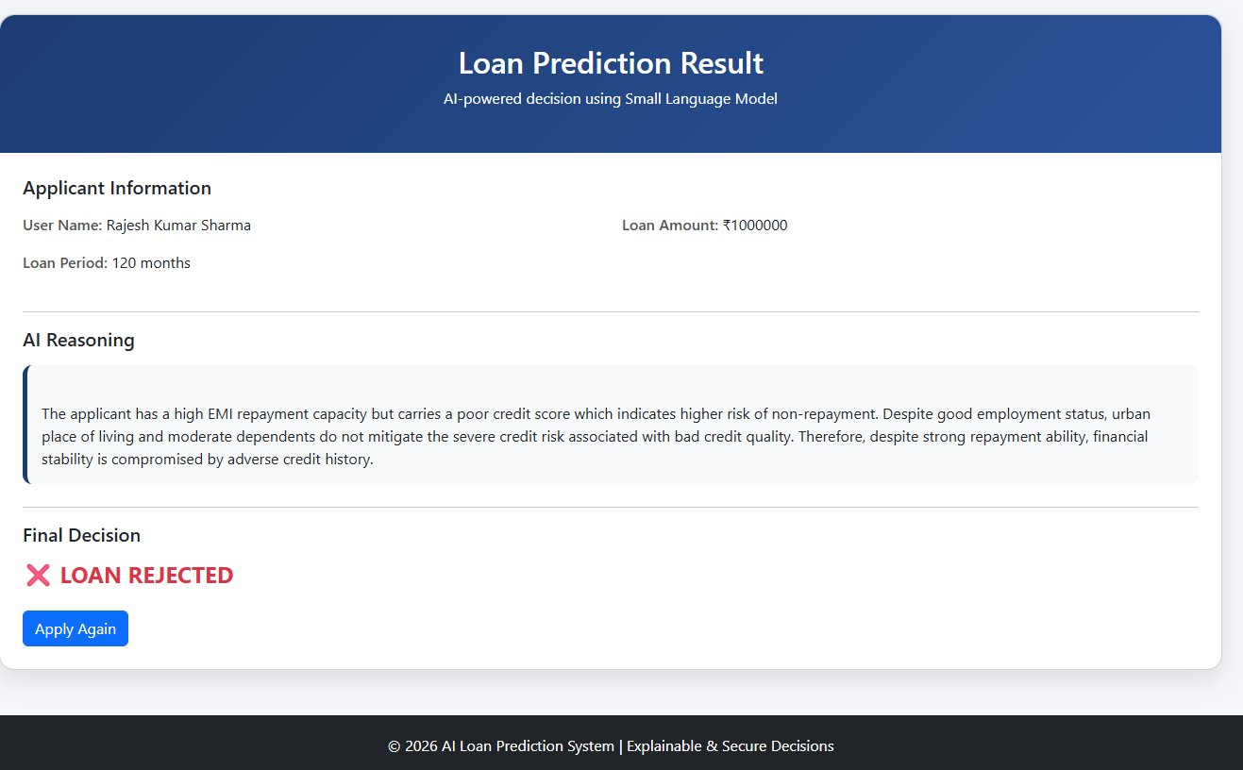
Results — Case 3: Loan Rejected
Applicant: Rajesh Kumar Sharma | Income : 45000| CIBIL: 425 | Dependents:2 | Loan: ₹10,00,000 | Decision: REJECTED
STEP 1 | Applicant Details
STEP 2 | Document Upload
STEP 3 | Loan Prediction Result
11 / 15

Slide 12
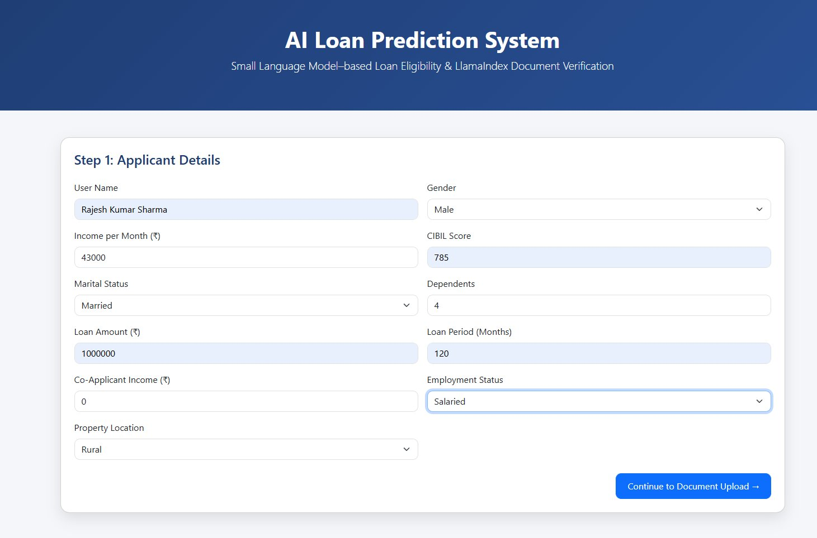
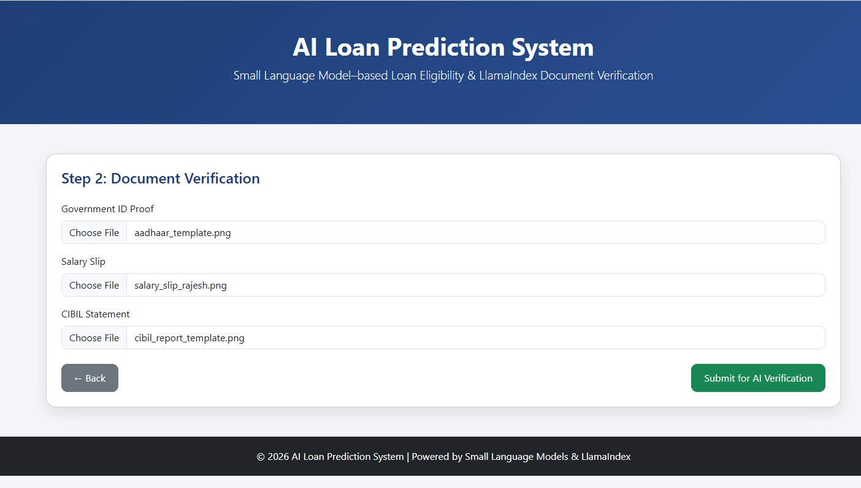
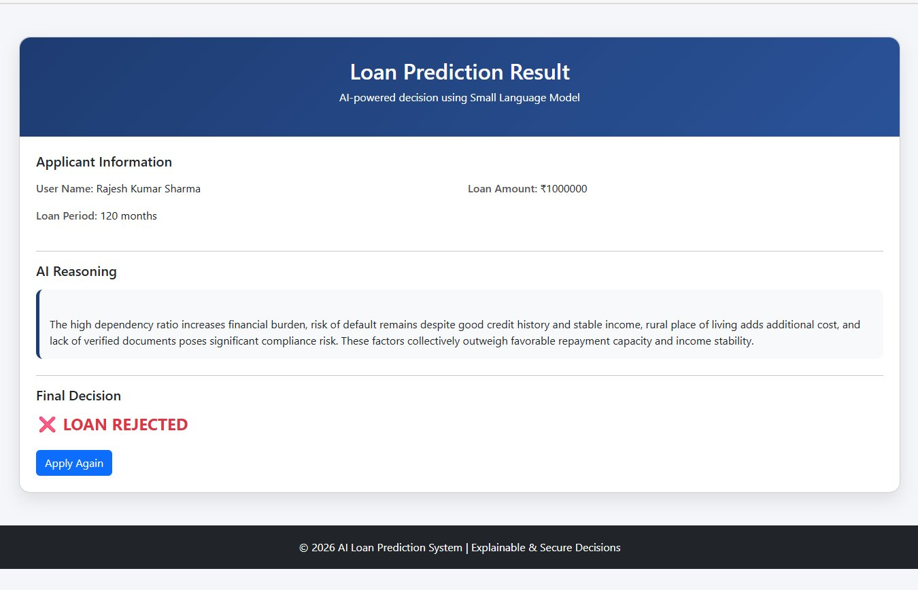
Results — Case 4: Loan Rejected
Applicant: Rajesh Kumar Sharma | Income: 43000 | CIBIL: 785 | Dependents:4 | Loan: ₹10,00,000 | Decision: REJECTED
STEP 1 | Applicant Details
STEP 2 | Document Upload
STEP 3 | Loan Prediction Result
19 / 15

Slide 13

Conclusion
This paper presented an AI-based Loan Eligibility Prediction and Document Verification System that fully automates the loan evaluation process — filling the gap in literature between automated document verification and AI-based loan eligibility forecasting.
Intelligent Document Parsing
Automated Cross-Verification
LlamaParse extracts structured data from identity proofs, salary slips and CIBIL reports with high accuracy across PDFs and images.
LlamaIndex cross-matches extracted document data vs. applicant entries, detecting mismatches and enhancing accuracy automatically.
Explainable AI Decisions
Significant Research Contribution
LoRA fine-tuned Qwen LLM delivers accurate loan predictions with transparent, human-readable reasoning for every applicant.
Fills the void in existing literature by combining automated document verification with AI-based loan eligibility prediction in one unified pipeline.
19 / 15

Slide 14
Published Research
International Journal of Creative Research Thoughts (IJCRT)
AI-Driven Loan Eligibility Prediction And Document Verification
IJCRT | Volume 14, Issue 3 | March 2026 | ISSN: 2320-2882 | Paper ID: IJCRT2603506
Authors
Publication Details
Batta Chaitanya Sri
Dontiboina Naga Lakshmi
Bellam Ravindra
Kalagotla Peeraiah
Ms. Dwija Desireddy (Guide)
Journal:
IJCRT (Peer-reviewed, Open Access)
Volume:
14, Issue 3 — March 2026
ISSN:
2320-2882
Paper ID:
IJCRT2603506
🔗 http://ijcrt.org/viewfull.php?&p_id=IJCRT2603506
19 / 15

Slide 15
Thank You!
Questions & Discussion Welcome

